Slide 1
INTRODUCTION
TO
C LANGUAGE
Prepared By
Anjan Kumar

Slide 2
The C programming language was designed by Dennis Ritchie at
AT & Bell Laboratories in the early 1970s.
Influenced by
ALGOL 60
CPL
BCPL
B

Slide 3
Standard C
ANSI C
C89
1995 (C95) and 1999 (C99)

Slide 4

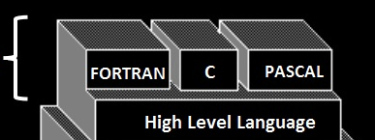
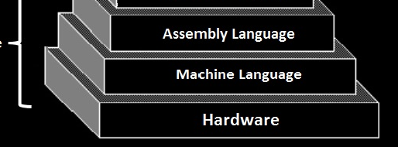

Classification Of Language

Slide 5
C is a middle level language

Slide 6
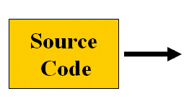

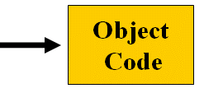

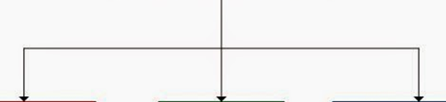



Translators :
Types of Translators :

Slide 7


